Slide 1

STRAIN ANALYSIS BASED ON EYE BLINKING
MAJOR PROJECT UG PHASE-1
DEPARTMENT OF COMPUTER SCIENCE AND ENGINEERING
VAAGDEVI ENGINEERING COLLEGE
PRESENTED BY:
SHARANYA THOTA - 21UK1A05Q4
SAI KUMAR SAMUDRALA - 22UK5A0521
HUSSAIN JAFAR HUSSIAN - 21UK1A05Q3
BANOTH VENKATNAIK - 21UK1A05M6
MUDAVATH NITHIN - 21UK1A05M7
UNDER THE GUIDANCE OF:
MS. SUSHMA. T
ASSISTANT PROFESSOR

Slide 2
TABLE OF CONTENTS
ABSTRACT
INTRODUCTION
PROBLEM STATEMENT
SOLUTION
EXISTING SYSTEMS
SYSTEM FUNCTIONALITY
WORKFLOW OF THE SYSTEM
SYSTEM DESCRIPTION
FUTURE SCOPE
ADVANTAGES
CONCLUSION
REFERENCES

Slide 3
ABSTRACT
This project aims to develop an artificial intelligence-based system to analyze strain using eye blinking patterns. By monitoring the frequency and duration of eye blinks, the system employs the Eye Aspect Ratio (EAR) metric to detect blinks and assess strain levels. The EAR is calculated by detecting facial landmarks and measuring the Euclidean distance between eye coordinates. This innovative approach allows for real-time monitoring and quantification of eye strain, providing valuable insights for individuals who spend prolonged periods in front of screens

Slide 4
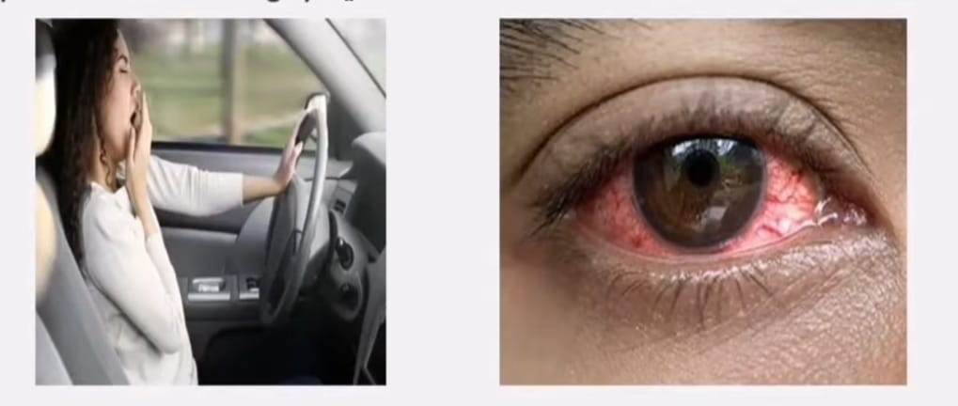
Strain analysis based on eye blinking involves using sensors or camera systems to monitor and measure eye blinks to assess eye strain. by analyzing the frequency and duration of blinks, this method helps identify signs of fatigue, especially during prolonged screen usage. it provides real-time feedback, allowing users to take timely breaks, which helps in maintaining better eye health and comfort
INTRODUCTION

Slide 5
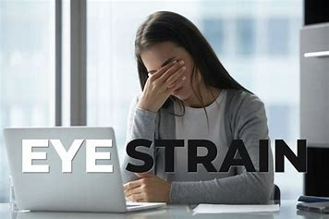
Eye strain is a growing issue due to prolonged screen usage for work, education, and entertainment. a primary symptom of strain is reduced or irregular blinking, which leads to dryness, irritation, and headaches, negatively impacting productivity and eye health. human eyes typically blink 10-14 times per minute, but during screen usage, this rate can drop significantly. Most users fail to notice this change, leading to delayed detection and worsening of strain symptoms. A system is needed to monitor blinking patterns in real time, detect strain early, and provide actionable feedback to users.
PROBLEM STATEMENT

Slide 6
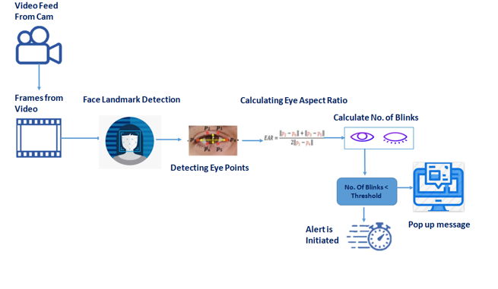
SOLUTION
A real-time system using a webcam tracks blink patterns via computer vision algorithms like Eye Aspect Ratio (EAR). It compares the blink rate with normal levels and alerts users if strain is detected. The system offers feedback, alerts, logs data, and provides insights to improve eye health. It can be integrated into apps, browser extensions, or wearables for easy use and continuous monitoring.

Slide 7
Existing Systems
Manual Observation:
Relies on supervisors to detect fatigue or stress.
Limitations: Prone to errors, inefficient.
Wearable Sensors:
Tracks physiological metrics like heart rate or brain activity.
Limitations: Invasive, expensive, uncomfortable.
CCTV-Based Systems:
Monitors facial expressions and eye movements.
Limitations: Affected by lighting, privacy concerns.
Vehicle-Based Detection:
Analyzes steering patterns or vehicle behavior.
Limitations: Indirect and less accurate.

Slide 8
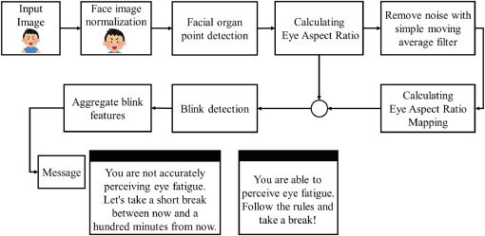
SYSTEM FUNCTIONALITY
This is how the system works:
Eye Tracking Technology: Using infrared sensors or cameras to detect blinks.
Data Processing: Analyzing blink rate, duration, and patterns.
Strain Analysis: Correlating blinking data with stress or fatigue levels using algorithms.
Real-Time Alerts: Sending notifications when strain levels exceed thresholds.

Slide 9
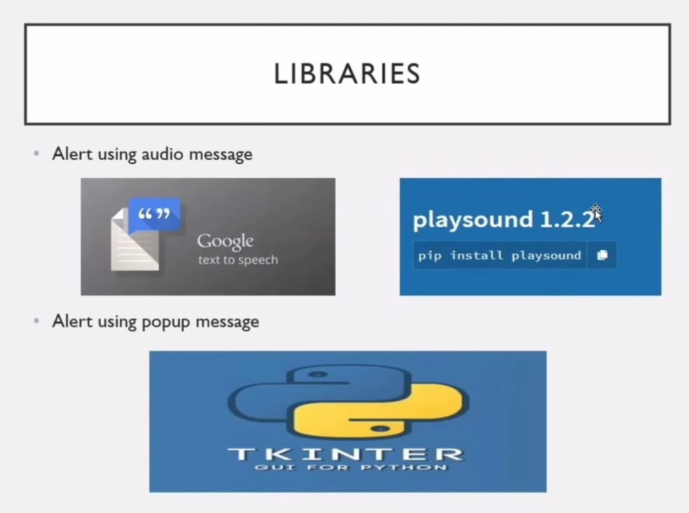
WORKFLOW OF THE SYSTEM
Data Collection:
Sensors capture eye movement and blinking
behavior.
Libraries:
Alert using audio message.
Alert using popup message.
Strain Analysis:
Identifying fatigue, stress, or workload based on
blinking.
Output Feedback:
Alert the user (e.g., warning signals for drivers).
Provide insights via reports for long-term
monitoring.

Slide 10
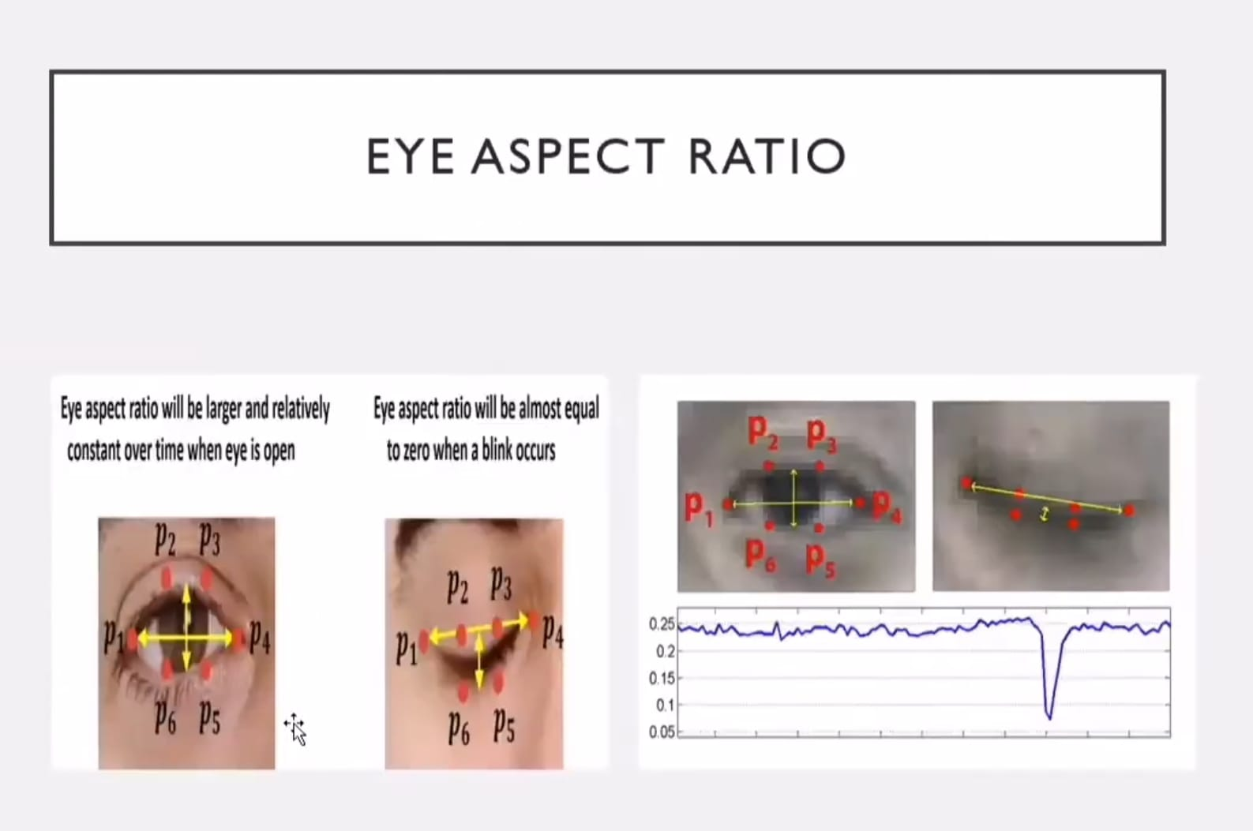
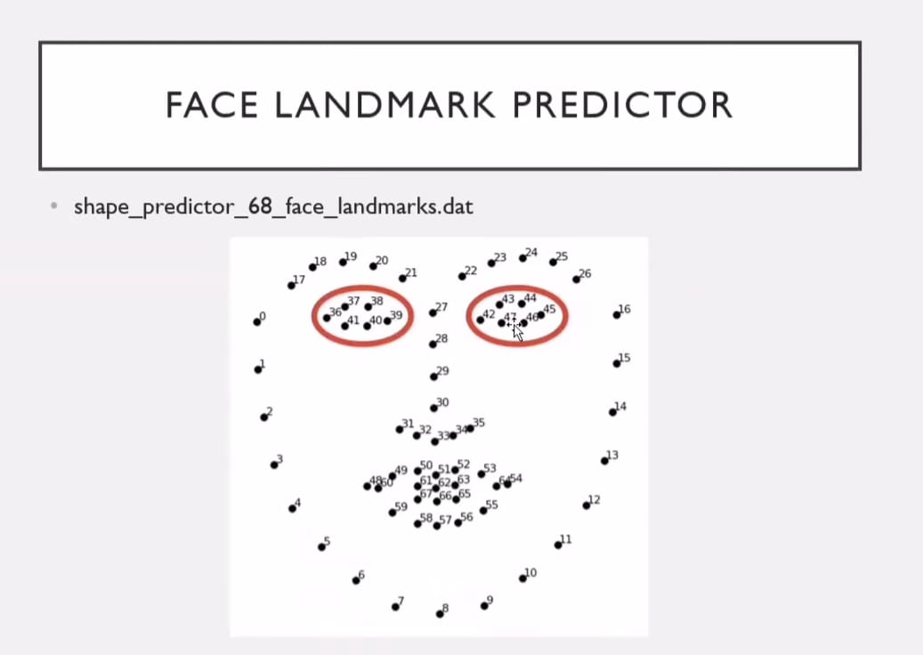
System Description

Slide 11
FUTURE SCOPE 1. Enhanced wearable devices: - smart glasses and contact lenses for continuous monitoring. 2. Ai and machine learning integration: - personalized recommendations and predictive analytics. 3. Comprehensive health monitoring: - combining blink analysis with other biometric data. 4. Advanced applications: - automotive industry, education, and workplace environments. 5. Research and development: - neurological studies and cognitive load assessment. 6. Ethical and privacy considerations: - data privacy and regulatory frameworks.

Slide 12
Advantages Non-invasive: no physical discomfort for the user. Real-time monitoring: immediate detection and alerts. Cost-effective: low-cost devices compared to medical-grade systems. Wide applicability: usable in multiple industries (workplace, healthcare, transportation). Improved safety: helps reduce accidents and improve mental health.

Slide 13
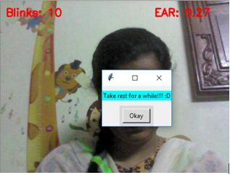
Conclusion
Strain analysis through eye blinking is a valuable method for assessing eye strain by monitoring blink frequency and duration. It involves detecting faces, identifying facial landmarks, and calculating the Eye Aspect Ratio (EAR) to determine blink occurrences. Applications range from health monitoring to workplace safety and enhancing human-computer interaction. This technique helps in maintaining eye health by providing real-time feedback and alerts, encouraging individuals to take breaks and reduce strain. As technology advances, the integration with wearables and AI can offer even more personalized and effective strain management solutions.

Slide 14
References
[1] T. Morris, P. Blenkhorn and F. Zaidi. Blink detection for real-time eye tracking. Journal of Network and Computer Applications, vol. 25, num. 2, pp. 129-143, April 2002
[2] S. Siro hey, A. Rosenfeld and Z. Duric . A method of detecting and tracking irises and eyelids in video. Pattern Recognition, vol. 35, num. 6, pp. 1389-1401, 2002.
[3] Ric Heishman and Zoran Duric . Using image flow to detect eye blinks in color videos. Proceedings of the Eighth IEEE Workshop on Applications of Computer Vision, pp. 52, 2007.
[4] Michael Chau and MargritBetke. Real Time Eye Tracking and Blink Detection with USB Cameras. Boston University Computer Science Technical Report No. 2005-12, May 2005.
[5] Gang Pan, Lin Sun, Zhaohui Wu and Shihong Lao. Eyeblink-based anti-spoofing in face recognition from a generic web camera. The 11th IEEE International Conference on Computer Vision (ICCV'07), Rio de Janeiro, Brazil, October 2007

Slide 15

Thank you

